Slide 1
内存管理之page fault
mmap
page fault

Slide 2
mmap
void *mmap(void *addr,
size_t length,
int prot,
int flags,
int fd,
off_t offset);
Protection, read/write/exec/none
flags,
shared/private/anon
file
abcdxxx……………………………………………………xx
length

Slide 3
mmap
查找可用的区间
vm_area_struct的字段 | 类型 | 描述
vm_start | unsigned long | 线性区间的开始
vm_end | unsigned long | 线性区间的结束，实际的区间为[vm_start, vm_end)
vm_page_prot | pgprot_t | 映射区域的保护方式
vm_flags | unsigned long | 映射的标志
vm_ops | vm_operations_struct * | 映射的相关操作
vm_file | file * | 映射的文件对应的file对象
vm_pgoff | unsigned long | 在文件内的偏移量
vm_rb | rb_node | 将它插入红黑树中
vm_next vm_prev | vm_area_struct * | 将它链接到链表中
vm_mm | mm_struct * | 所属的mm_struct

Slide 4
mmap
struct file_operations {
int (*mmap) (struct file *, struct vm_area_struct *);
};
int call_mmap(struct file *file, struct vm_area_struct *vma)
{
return file->f_op->mmap(file, vma);
}

Slide 5
file mmap
int my_mmap1(struct file *file, struct vm_area_struct *vma)
{
struct my_dev_data *dev_data;
//省略
dev_data = file->private_data;
addr = dev_data->io_addr1;
//省略
return vm_iomap_memory(vma, addr, len);
}

Slide 6
file mmap
int my_mmap2(struct file *file, struct vm_area_struct *vma)
{
//省略
page = alloc_pages(flags, order);
remap_pfn_range(vma, vma->vm_start, page_to_pfn(page), size,
vma->vm_page_prot );
return ret;
}

Slide 7
file mmap
static int my_mmap_fault(struct vm_area_struct *area, struct vm_fault *vmf)
{
struct file *file = area->vm_file;
vmf->page = alloc_page(flag);
//do your work here
}
static const struct vm_operations_struct my_file_mmap =
{
.fault = my_mmap_fault,
};
static int my_mmap3(struct file *file, struct vm_area_struct *vma)
{
vma->vm_ops = &my_file_mmap;
return 0;
}

Slide 8
brk
vma = vm_area_alloc(mm);
if (!vma) {
vm_unacct_memory(len >> PAGE_SHIFT);
return -ENOMEM;
}
vma_set_anonymous(vma);
vma->vm_start = addr;
vma->vm_end = addr + len;
vma->vm_pgoff = pgoff;
vma->vm_flags = flags;
vma->vm_page_prot = vm_get_page_prot(flags);

Slide 9
内存管理之page fault
mmap
page fault

Slide 10
page fault
vma = find_vma(mm, address);
if (unlikely(!vma)) {
bad_area(regs, hw_error_code, address);
return;
}
handle_mm_fault(vma, address, flags);

Slide 11
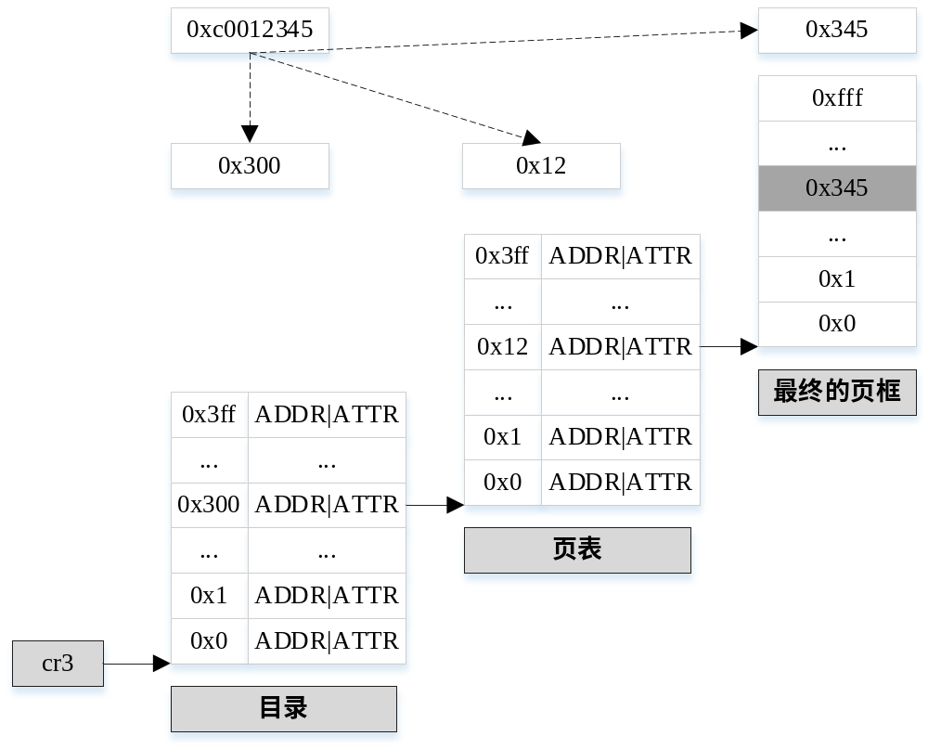
mapping
mmap1
mmap2

Slide 12
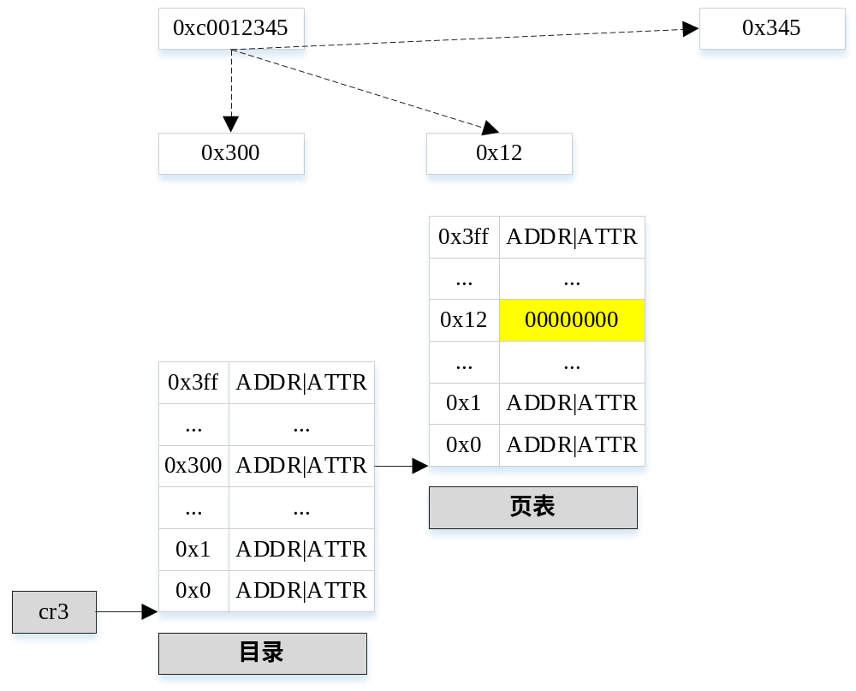
pte none
pte_none

Slide 13
pte none
zero page if !write
if (!vmf->pte) {
if (vma_is_anonymous(vmf->vma))
return do_anonymous_page(vmf);
else
return do_fault(vmf);
}
alloc page if write
read
shared
cow
vma->vm_ops->fault()
cow_page
copy page
map cow_page

Slide 14
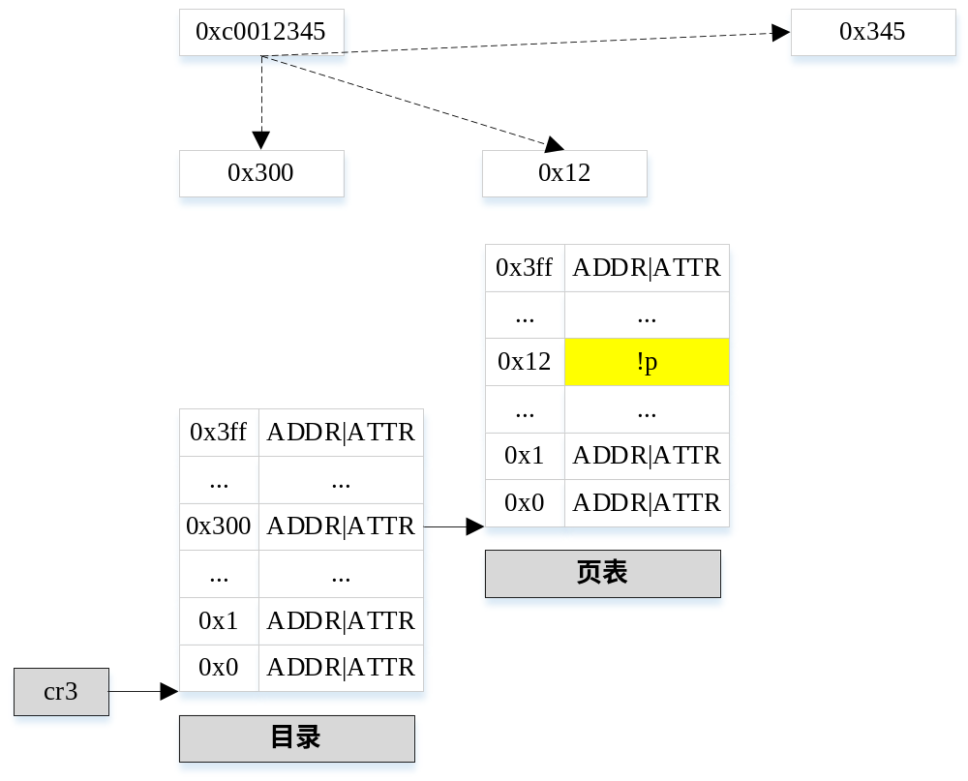
swap
!pte_present

Slide 15
swap
page
/swapfile
write
alloc
…
…
alloc

Slide 16
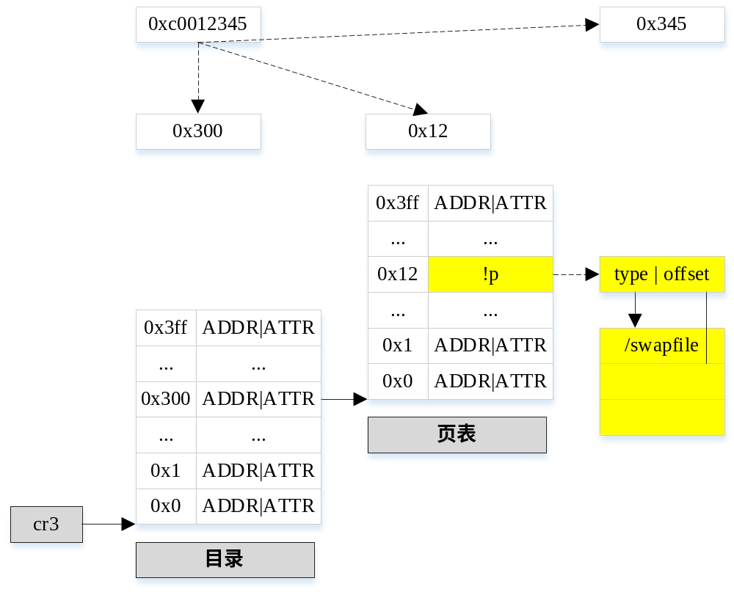
swap

Slide 17
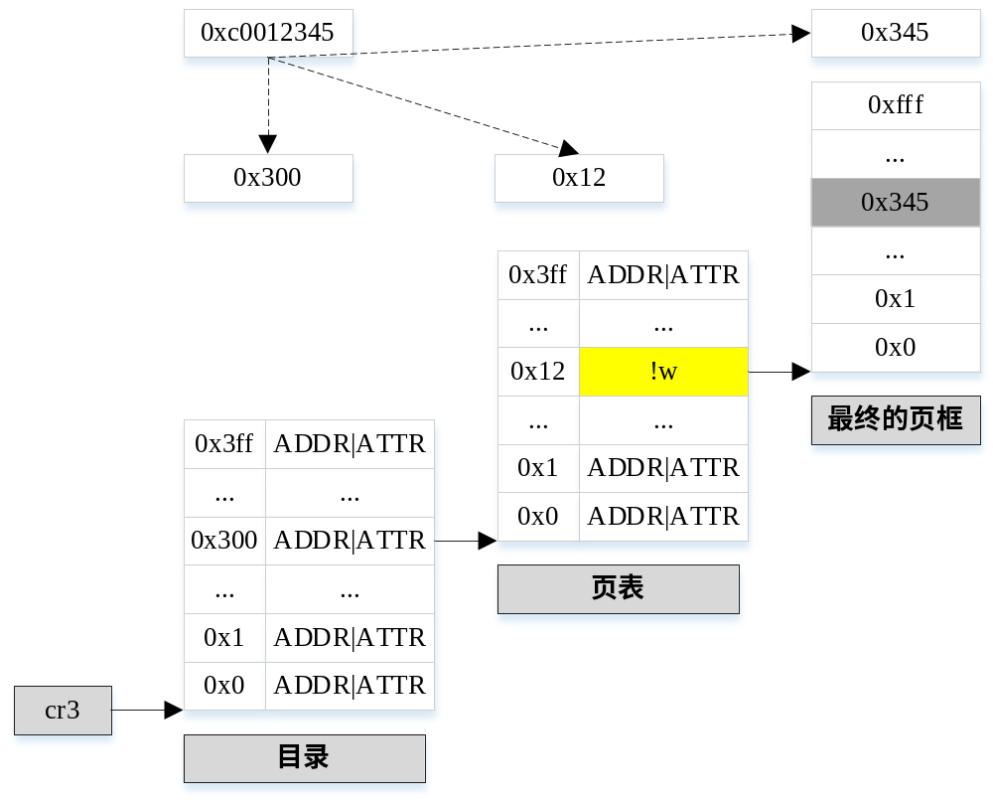
COW
private
write

Slide 18
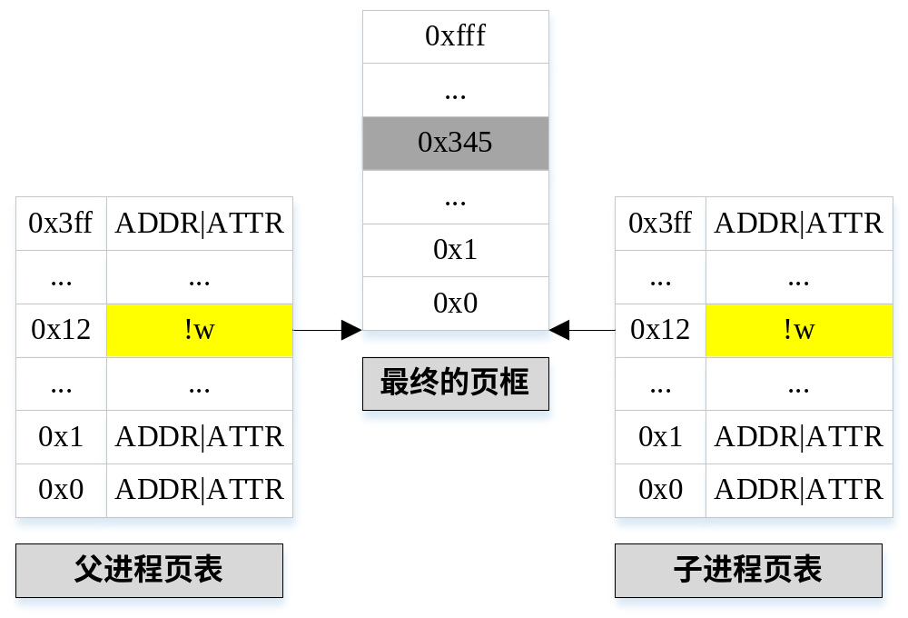
COW

Slide 19
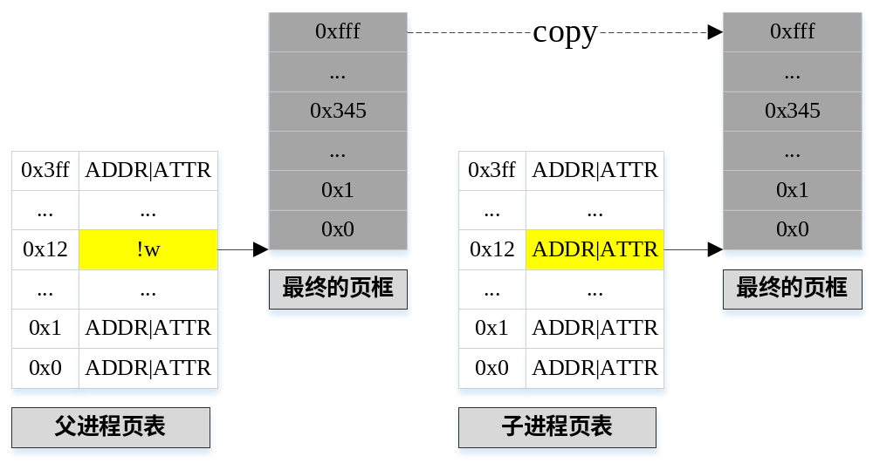
COW

Slide 20
Thanks

